Slide 1
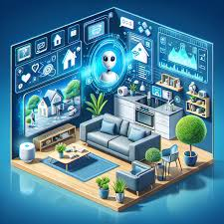
Artificial Intelligence in Daily Life
Smart Phones Uses in AI
Like digital assistants
Chat bots
Social media website

Slide 2
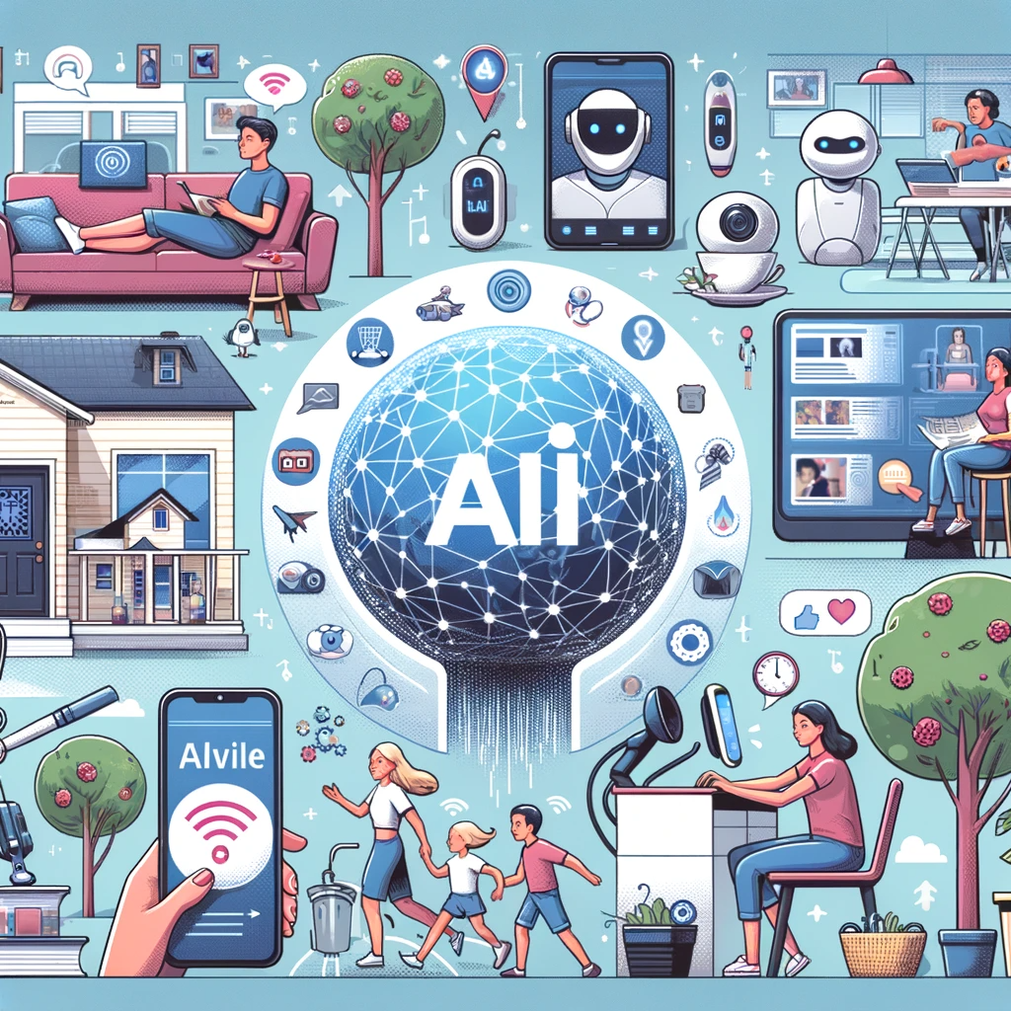
Ways you can use AI Today
Siri
Alexa
Google assistant
Responded to voice commands
Perform internet service
Manage schedules
Control smartphone devices etc.

Slide 3
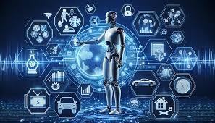
What AI used for today ?
Manufacturing Robots
Self driving cars
Smart assistants
Health care managements
Automated financial investing
Virtual travel booking agent
Social media marketing
Sarketing Chatbots

Slide 4
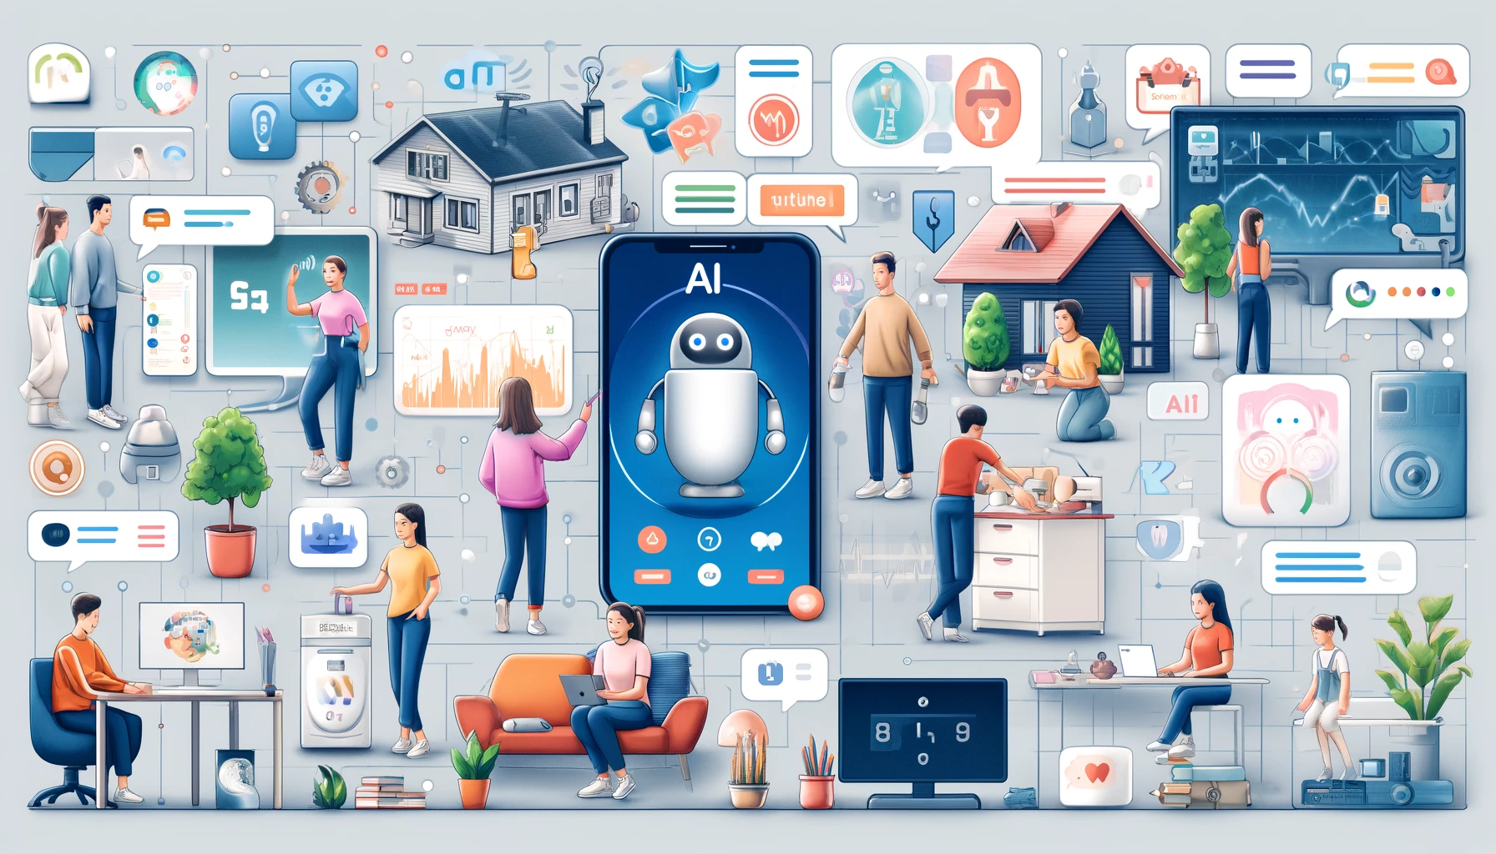
AI do we use in daily life?
Maps & navigations
Financial Detection & Recognition
Text editors or Auto correct
Search & Recommendation Algorithm
Chatbots
Digital Assistants
Social media
E-payments
Gpay
Phone pay, etc.
Page no.20

Slide 5
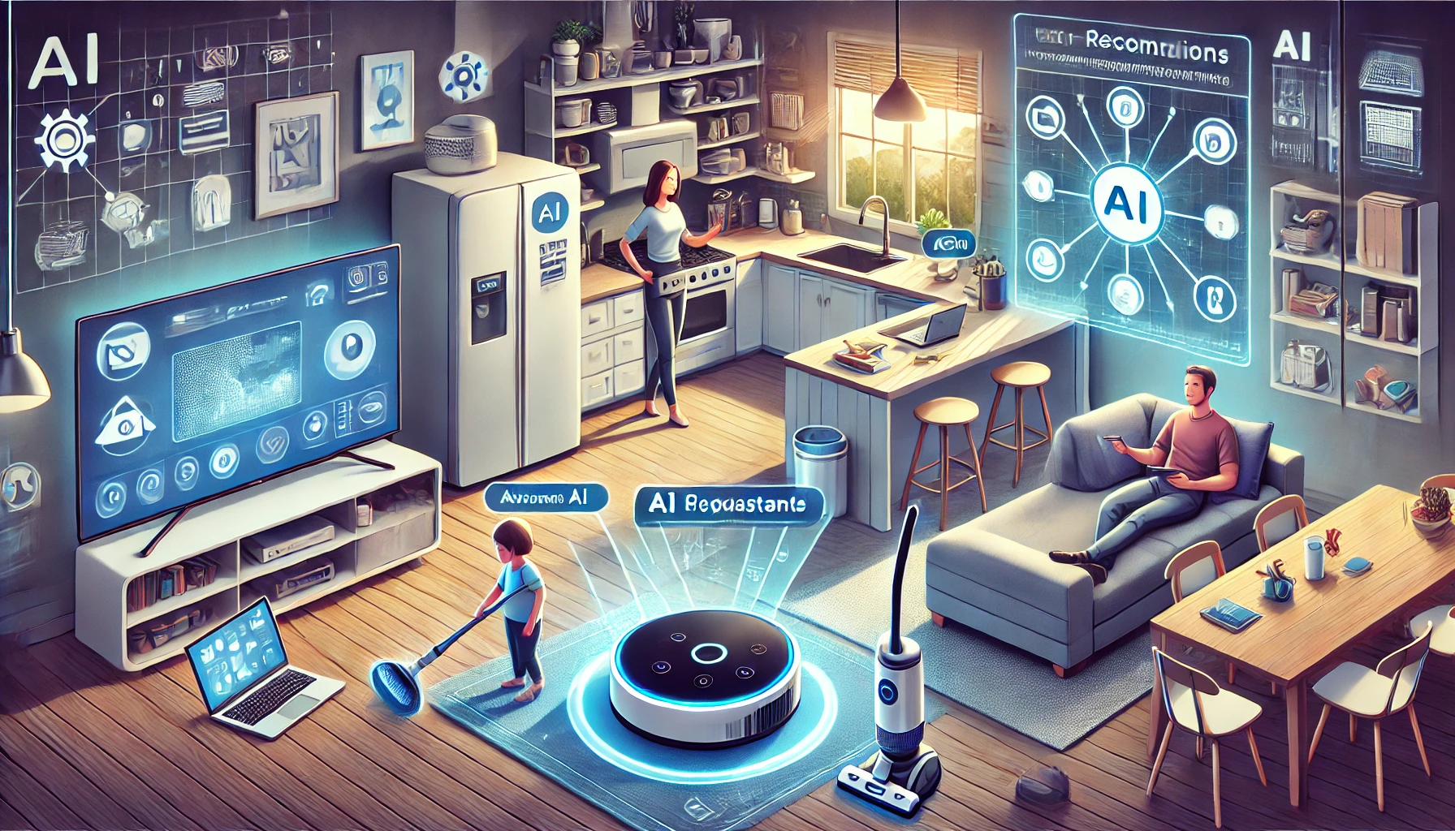
AI used at home
Smart camaras
Smart assistants
Kitchen appliances
smart thermal stats
Smart plugs
AI cleaners
Door lockers

Slide 6
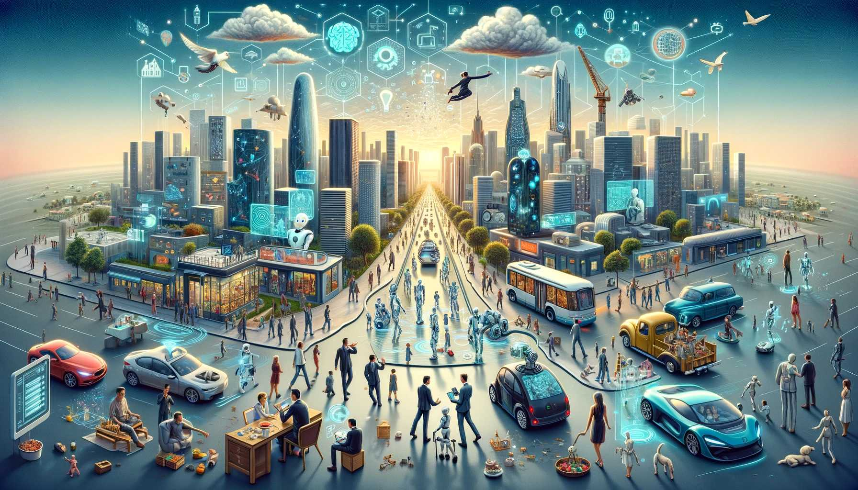
AI used in Society
Many industries
Health care
Financial
Education
Improved Efficiency
Reduced costs
Increased accuracy in various fields

Slide 7
AI Advantages of daily life
AI Disadvantages of daily life
Reducing human errors
Time saving capabilities
digital assistance
Unbiased decisions
Emotional intelligence
Encouraging human laziness
Job Displacement
AI implementation is costly

Slide 8
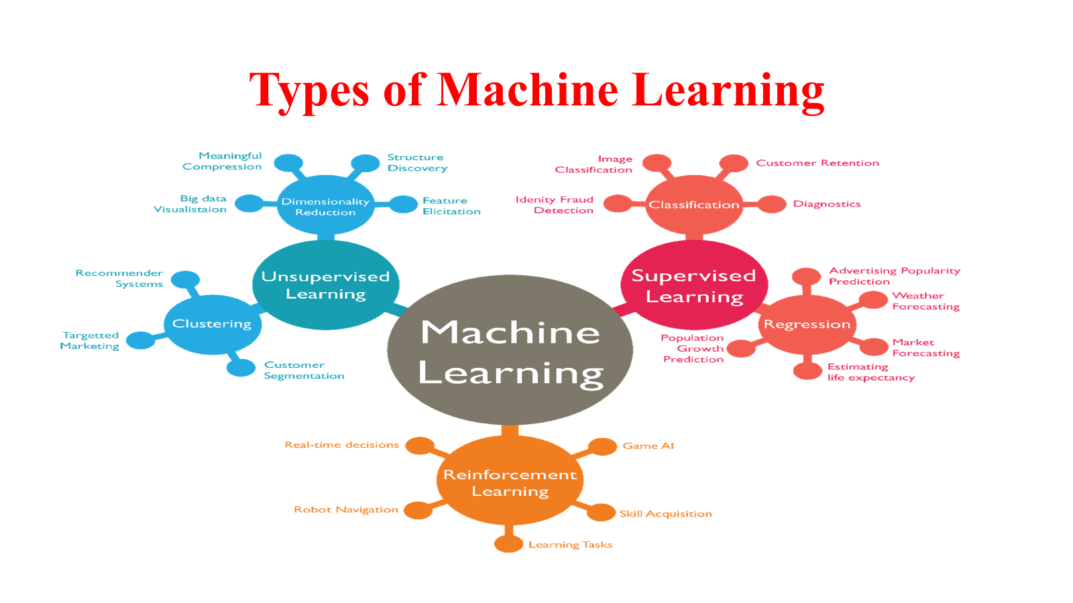

Slide 9
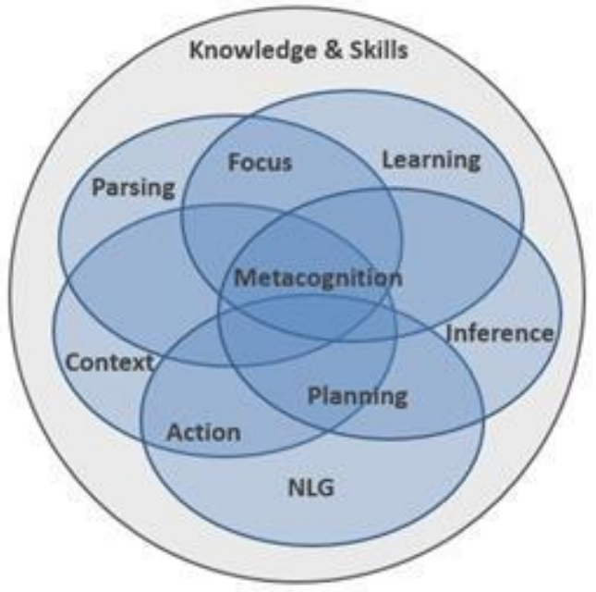
COGNATIVE ARCHITECTURE

Slide 10
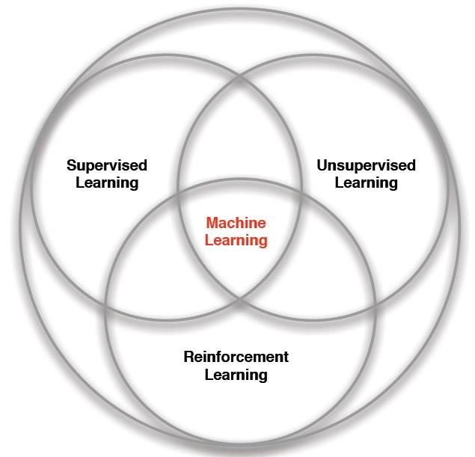

Slide 11

Thank you
Page no.39

